Slide 1
Pointers, Polymorphism, and
Memory Allocation

Slide 2
Memory Allocation for Variables and Early Binding of Methods
Declare variable x to have data type int
  C++ compiler allocates memory cell to hold an integer
  Use the identifier x to refer to this cell
A function’s locally declared variables
  Placed into an activation record with parameters and bookkeeping data
  Activation record placed on run-time stack
  Activation record destroyed when function finished

Slide 3
Memory Allocation for Variables and Early Binding of Methods
Storage for data members of an object
  Also placed into an activation record.
  Data fields placed on the run-time stack just as primitive data types are.
This is early binding , made during compilation
  Cannot be altered during execution

Slide 4
Memory Allocation for Variables and Early Binding of Methods
Automatic memory management and early binding sometimes insufficient
  Need to take advantage of polymorphism.
  Must access an object outside of the function or method that creates it.

Slide 5
Problem to Solve
Need to write a function – takes two arguments:
  An object of any of the three types of boxes (from Interlude 1)
  An item of type string
Function should place item in box by invoking box’s setItem method

Slide 6
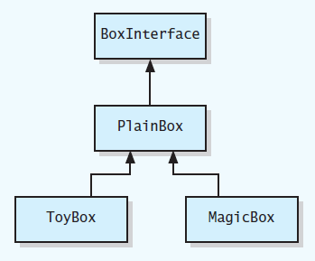
Problem to Solve
UML class diagram for a family of classes

Slide 7
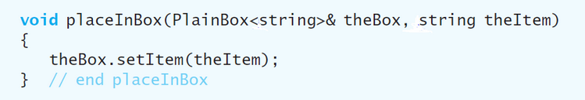
Problem to Solve
You may think this function would suffice

Slide 8
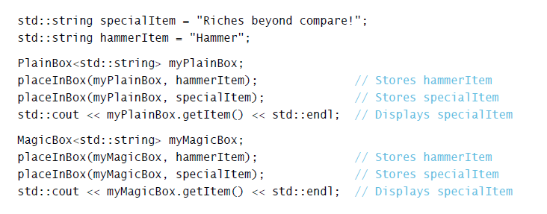
Problem to Solve
Used in this context
Code compiles, but does not perform as you would expect due to

Slide 9
Problem to Solve
Version of setItem called is determined when the program is compiled.
Need a way to communicate to compiler
  Code to execute should not be determined until program is running.
  Called late binding

Slide 10
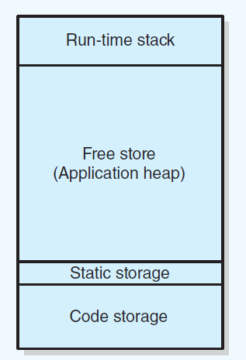
Pointers and Program’s Free Store
Sample program memory layout

Slide 11
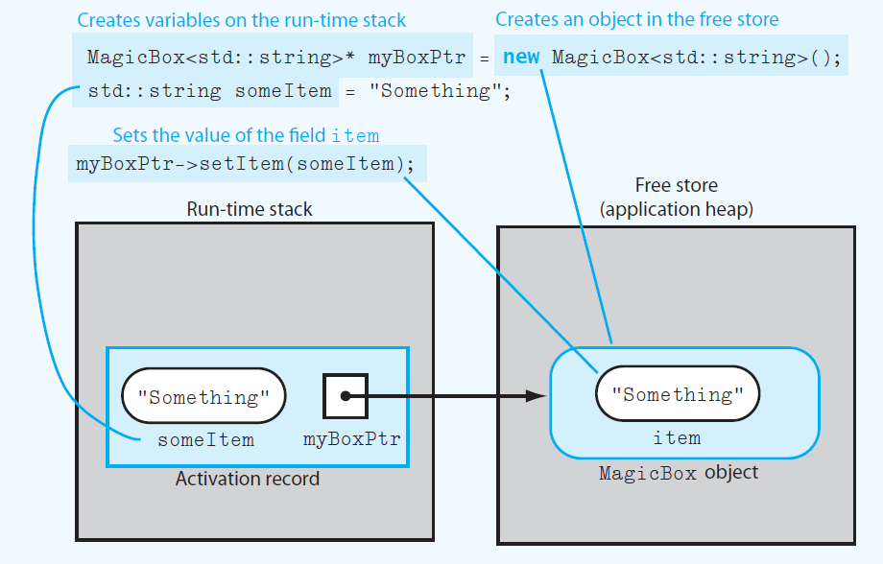
Pointers and Program’s Free Store
Run-time stack and free store after myboxPtr points to a MagicBox object and its data member item is set

Slide 12
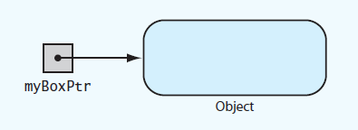
Pointers and Program’s Free Store
myBoxPtr and the object to which it points

Slide 13
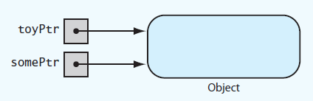
Pointers and Program’s Free Store
Two pointer variables that point to the same object

Slide 14
Deallocating Memory
When memory to which pointer variable points is no longer needed
  Deallocate it by using delete operator.
Then set pointer variable to nullptr
Otherwise dangling pointer exists
  It would still contain address of object that was deallocated.
  Can be source of serious errors.

Slide 15
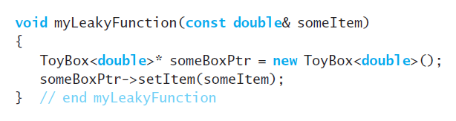
Avoiding Memory Leaks
Memory leaks occur when
  An object has been created in the free store, but
  Program no longer has a way to access
Poorly written function
that allocates memory in the free store

Slide 16
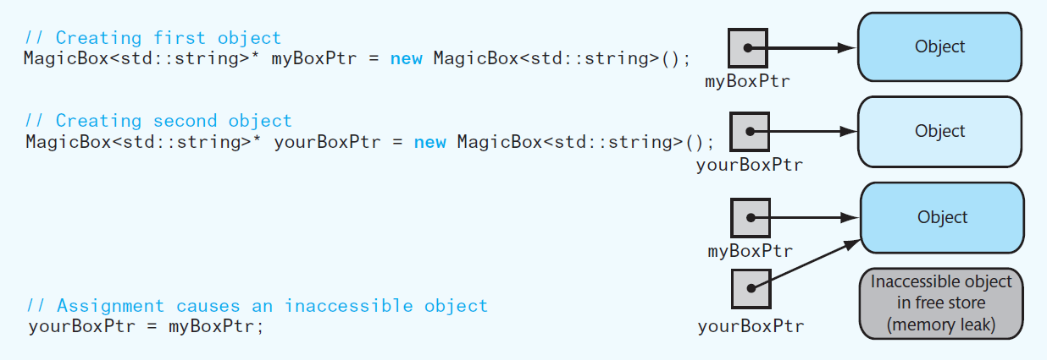
Avoiding Memory Leaks
An assignment that causes an inaccessible object.
To prevent memory leak, do not use a function to return a pointer to a newly created object

Slide 17
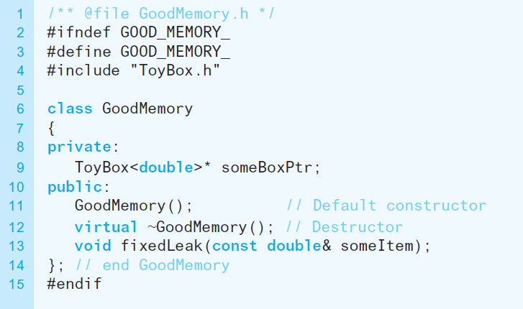
Avoiding Memory Leaks
Header file for the class GoodMemory

Slide 18
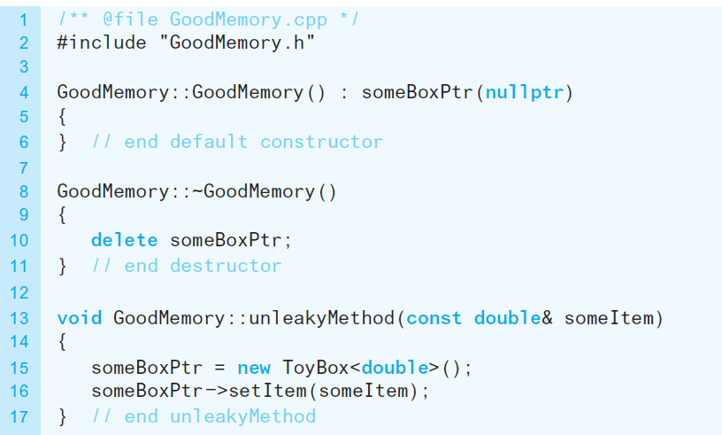
Avoiding Memory Leaks
Implementation file for the class GoodMemory

Slide 19
Avoiding Dangling Pointers
Situations that can cause dangling pointer
  if you do not set a pointer variable to nullptr after using delete
  If you declare a pointer variable but do not assign it a value

Slide 20
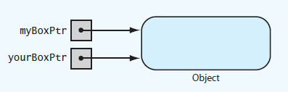
Avoiding Dangling Pointers
Two pointers referencing
(pointing to) the same object

Slide 21
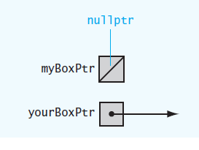
Avoiding Dangling Pointers
Example of a dangling pointer

Slide 22
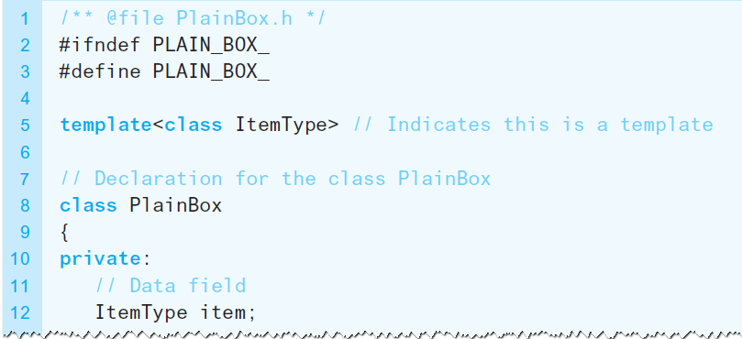
Virtual Methods and Polymorphism
Allow compiler to perform the late binding necessary for polymorphism
  Declare methods in base class as virtual.
Revised header file for the class PlainBox

Slide 23
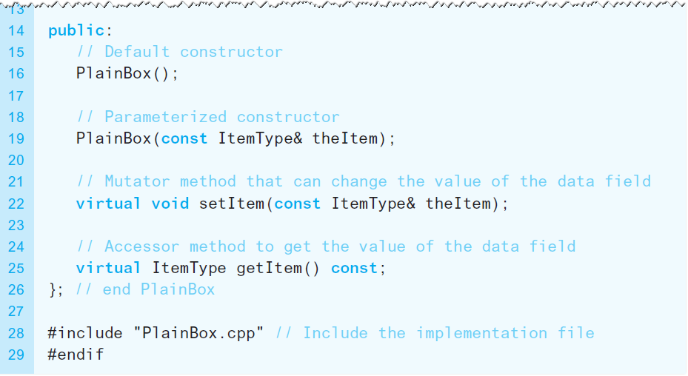
Virtual Methods and Polymorphism
Revised header file for the class PlainBox

Slide 24
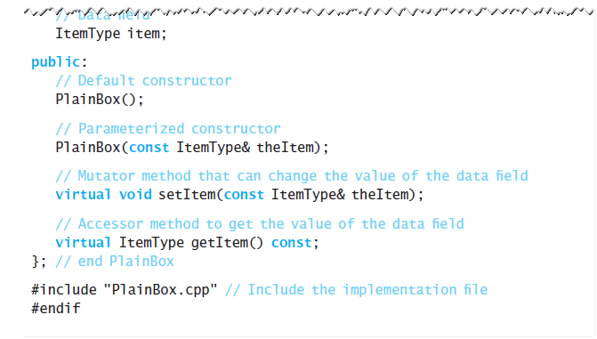
Virtual Methods and Polymorphism
Revised header file for the class PlainBox

Slide 25
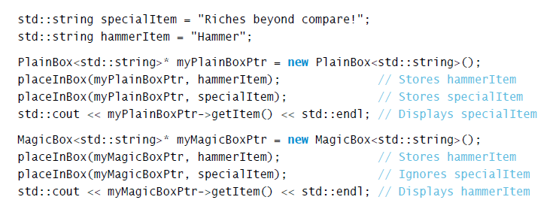
Virtual Methods and Polymorphism
To fully implement late binding, create variables in
free store and use pointers to reference them

Slide 26

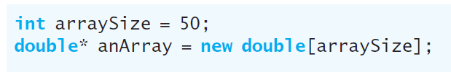
Dynamic Allocation of Arrays
An ordinary C++ array is statically allocated
Can use new operator to allocate an array dynamically

Slide 27

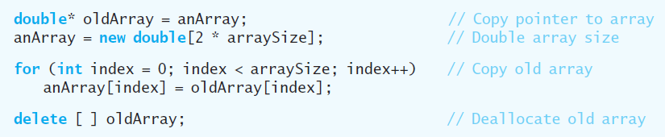
Dynamic Allocation of Arrays
delete returns a dynamically allocated array to system for reuse
Increase size of dynamically allocated array

Slide 28
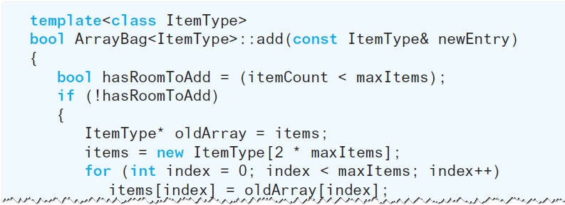
A Resizable Array-Based Bag
Use a resizable array to implement ADT bag so that bag never becomes full

Slide 29
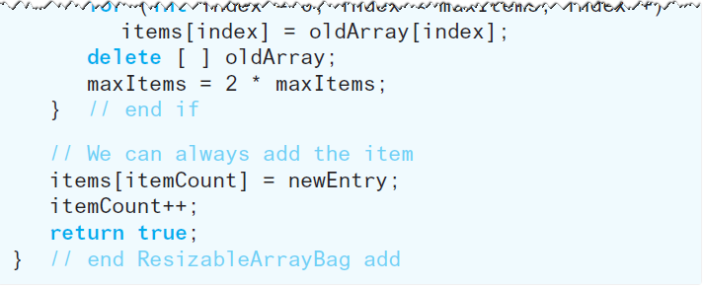
A Resizable Array-Based Bag
Use a resizable array to implement ADT bag so that bag never becomes full

